Slide 1
Name resolution between DNS zones

Slide 2
Agenda
Resolving DNS names between zones
Stub zone
DNS caching
DNS forwarding
DNS forwarding vs. stub zone
Configuring delegation

Slide 3
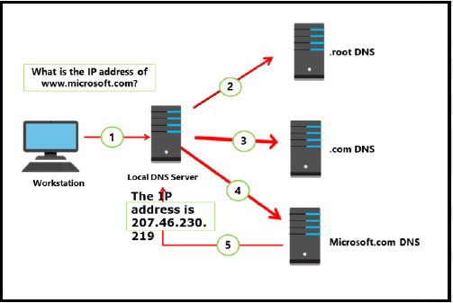
When DNS names resolve on the Internet, an entire system of computers is used rather than just a single server. There are hundreds of servers on the Internet, called root servers, which manage the overall practice of DNS resolution. These servers are represented by 13 FQDNs. A list of these 13 servers is preloaded on each DNS server. When you register a domain name on the Internet, you are paying to become part of this system.
Example:
1. A workstation queries the local DNS server for the IP address www.microsoft.com.
2. If the local DNS server does not have the information, it queries a root DNS server for the location of
the .com DNS servers.
3. The local DNS server queries a .com DNS server for the location of the microsoft.com DNS servers.
4. The local DNS server queries the microsoft.com DNS server for the IP address of www.microsoft.com.
5. The IP address www.microsoft.com is returned to the workstation.

Slide 4
You can modify the name resolution process by configuring caching or forwarding:
Caching. After a local DNS server resolves a DNS name, it caches the results for the period of time defined by the time to live (TTL) value in the SOA record for the DNS zone. The default TTL is one hour. Subsequent resolution requests for the DNS name are given the cached information. Note that the TTL is not set by the caching server, but instead by the authoritative DNS server that resolved the name from its zone. When the TTL expires, the caching server must delete it. Subsequent requests for the same name would require a new name resolution request to the authoritative server.
Forwarding. Instead of querying root servers, you can configure a DNS server to forward DNS requests to another DNS server. For example, requests for all Internet names can be forwarded to a DNS server at an Internet service provider (ISP).

Slide 5
Agenda
Resolving DNS names between zones
Stub zone
DNS caching
DNS forwarding
DNS forwarding vs. stub zone
Configuring delegation

Slide 6
Stub zone
A stub zone resolves names between separate DNS namespaces, which might be necessary when a corporate merger requires that the DNS servers for two separate DNS namespaces resolve names for clients in both namespaces. A stub zone consists of the following:
The delegated zone’s Start of Authority resource record, NS resource records, and A resource records.
The IP address of one or more master servers that you can use to update the stub zone.
The master servers for a stub zone are one or more DNS servers that are authoritative for the child zone, usually the DNS server that is hosting the primary zone for the delegated domain name.
The DNS server stores the resource records it receives from the authoritative DNS servers that a stub zone
in its cache lists, but it does not store these resource records in the stub zone itself. Only the Start of
Authority, NS record, and just the A resource records that resolve the NS records returned in response to the query are stored in the stub zone.
The resource records that the cache stores are cached according to the time to live (TTL) value in each resource record.
The Start of Authority, NS record, and glue A resource records, which are not written to cache, expire according to the expire interval that the stub zone’s Start of Authority record specifies. During the stub zone’s creation, the Start of Authority record is created.
Start of Authority record updates occur during transfers to the stub zone from the original, primary zone. If the query was an iterative query, the DNS server returns a referral containing the servers that the stub zone specifies.

Slide 7
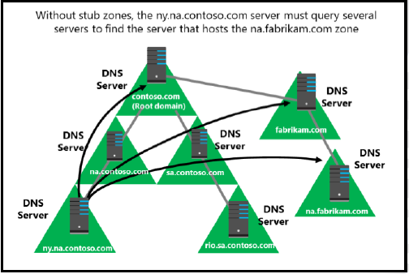
Stub zone
Stub zone resolution
When a DNS resolver performs a recursive query operation on a DNS server that is hosting a stub zone,
the DNS server uses the resource records in the stub zone to resolve the query. The DNS server sends an
iterative query to the authoritative DNS servers that the stub zone’s NS resource records specify as if it
were using NS resource records in its cache. If the DNS server cannot find the authoritative DNS servers in
its stub zone, the DNS server that is hosting the stub zone attempts standard recursion by using root
hints.

Slide 8
Agenda
Resolving DNS names between zones
Stub zone
DNS caching
DNS forwarding
DNS forwarding vs. stub zone
Configuring delegation

Slide 9
DNS caching increases the performance of an organization’s DNS by decreasing the time it takes to resolve a DNS host name. When a DNS server resolves a DNS name successfully, it adds the name to its cache. Over time, this builds a cache of domain names and their associated IP addresses for the most common domains that the organization uses or accesses.
The default time to cache DNS data is one hour. You can configure this by changing the TTL value of an SOA record for the appropriate DNS zone
To view the DNS Resolver Cache: Get-DNSClientCache To delete the DNS Resolver Cache: Clear-DNSClientCache
A caching-only server does not host any DNS zone data; it only answers lookups for DNS clients. The DNS client cache is a DNS cache that the DNS client service stores on the local computer To view the current client-cache: ipconfig /displaydns To clear the local client-cache: ipconfig /flushdns

Slide 10
Agenda
Resolving DNS names between zones
Stub zone
DNS caching
DNS forwarding
DNS forwarding vs. stub zone
Configuring delegation

Slide 11
Forwarding provides a way for namespaces or resource records not contained in a DNS server’s zone to be passed on to another DNS server for resolution.
For example, you might want to send all external name resolution requests to the DNS servers of the Internet service provider rather than directly to the root hints. Alternatively, you might want to send external DNS queries from a branch office DNS server to the head office DNS servers, which then go to the root hints to resolve the name.
You also can use conditional forwarders to forward queries according to specific domain names.
By using a forwarder, you can manage name resolution for names outside your network, such as names on the Internet, and improve the efficiency of name resolution for your network’s computers.
Best Practice: Use a central forwarding DNS server for Internet name resolution. This security best practice can improve performance and simplify troubleshooting. You can locate the forwarding DNS server on a perimeter network, which ensures that no server within the network is communicating directly to the Internet.

Slide 12
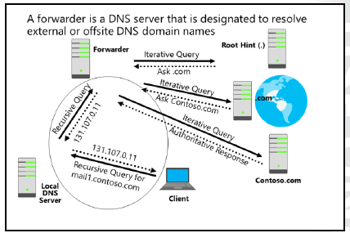
To configure forwarders on a DNS:
1. In the DNS Manager console, right-click the DNS server name, and then click Properties.
2. On the Forwarders tab, click Edit, and then add DNS servers that can be used to forward DNS
queries for external DNS names.

Slide 13
Agenda
Resolving DNS names between zones
Stub zone
DNS caching
DNS forwarding
DNS forwarding vs. stub zone
Configuring delegation

Slide 14
These settings have different purposes:
A conditional forwarder setting configures the DNS server to forward a query that it receives to a DNS server, depending on the DNS name that the query contains.
A stub zone keeps the DNS server that is hosting a parent zone aware of all the DNS servers that are authoritative for a child zone.
When to use conditional forwarders
If you want DNS clients on separate networks to resolve the names of each other without having to query Internet DNS servers, such as when a company merger occurs, you should configure each network’s DNS servers to forward queries for names in the other network. DNS servers in one network will forward names for clients in the other network to a specific DNS server, which builds a large information cache about the
other network. This allows you to create a direct point of contact between two networks’ DNS servers, which reduces the need for recursion.
Stub zones do not provide the same server-to-server benefit, however. This is because a DNS server that is hosting a stub zone in one network replies to queries for names in the other network with a list of all authoritative DNS servers for the zone with that name, rather than the specific DNS servers that you designated to handle this traffic.
When to use stub zones
Use stub zones when you want a DNS server to remain aware of the authoritative DNS servers for a
foreign zone.
A conditional forwarder is not an efficient way to keep a DNS server that is hosting a parent zone aware of the authoritative DNS servers for a child zone. This is because whenever the authoritative DNS servers for the child zone change, you must configure the conditional forwarder setting manually on the DNS server that hosts the parent zone. Specifically, you must update the IP address for each new authoritative DNS server for the child zone.

Slide 15
Agenda
Resolving DNS names between zones
Stub zone
DNS caching
DNS forwarding
DNS forwarding vs. stub zone
Configuring delegation

Slide 16
Configuring delegation
DNS is a hierarchical system, and zone delegation connects the DNS layers. A zone delegation points to the next hierarchical level down and then identifies the name servers that are responsible for the lower-level domain.
When deciding whether to divide a DNS namespace to make additional zones, consider the following scenarios in which you might use additional zones:
• You need to delegate management of a part of the DNS namespace to another organizational location or department.
• You need to divide one large zone into smaller zones so you can distribute traffic loads among multiple servers. This improves DNS name-resolution performance, and it creates a more fault tolerant DNS environment.
• You need to extend the namespace by adding numerous subdomains immediately to accommodate the opening of a new branch or site.

Slide 17
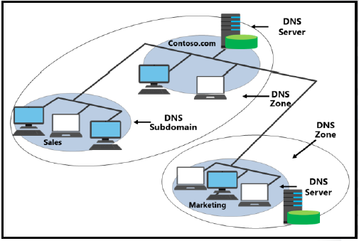
Configuring delegation
Zone delegation works similar to a top-level domain with a secondary-level domain. For example, the .com DNS servers refer all requests for Microsoft.com zone name resolution to the DNS servers at Microsoft. In this way, you delegate the Microsoft DNS zone from the .com zone.
In a scenario where Microsoft has a very large sales department with numerous computers and other devices with IP addresses, it would make sense to create a zone named Sales.Microsoft.com to handle the extensive DNS
workload for the sales department.

